Slide 1
Molecular mechanics, Molecular Dynamics
Instructor: Prof. Tzuhsiung (Nick) Yang
Email: tyang@mx.nthu.edu.tw
Time: M5/6
Room: NTHU Library Comp Lab II
Notes:
Rafael Gomez

Slide 2
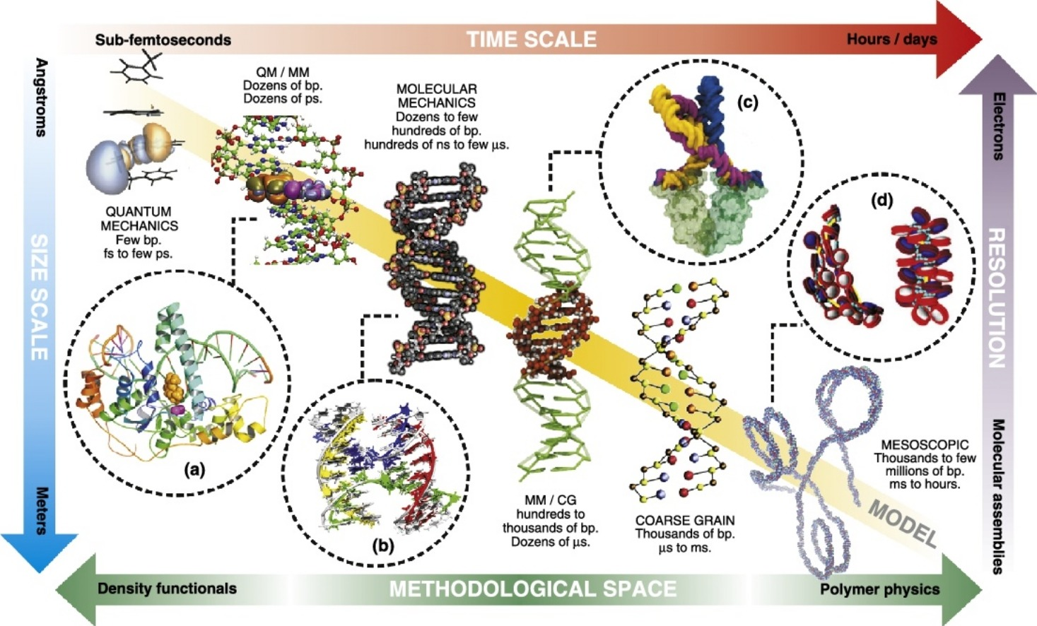
Multiscale simulation
Dans, P. D.; Walther, J.; Gómez, H.; Orozco, M. Multiscale Simulation of DNA. Current Opinion in Structural Biology 2016, 37, 29–45.

Slide 3
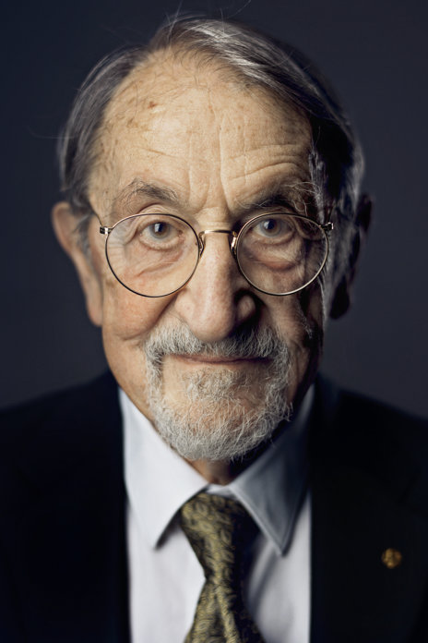
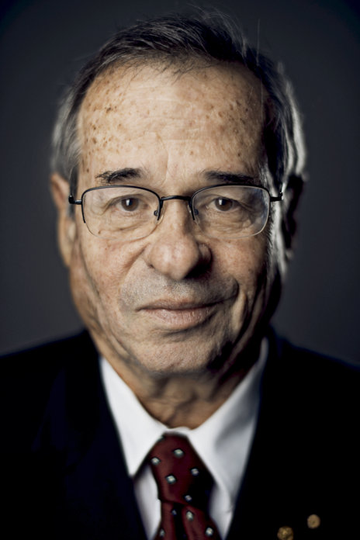
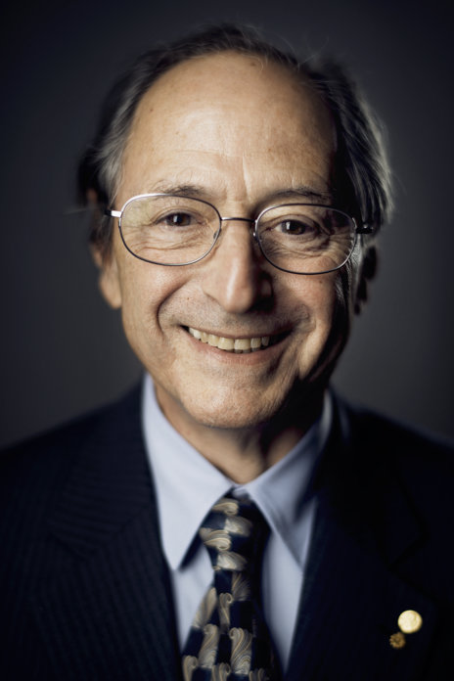
Nobel Prize in Chem 2013
Prize motivation: “for the development of multiscale models for complex chemical systems”
Martin Karplus
Arieh Warshel
Michael Levitt

Slide 4
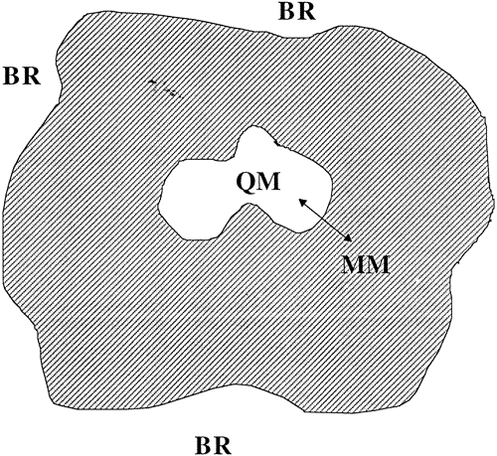
Multiscale simulation
The idea behind multiscale simulation is to combine models at different levels of detail to simulate the behavior of a system as a whole.
There are several combinations commonly used:
QM/QM2, where QM2 is a lower level QM method such as DFT tight binding (DFTB such as extended tight binding XTB), semi-empirical methods (PM6, AM3, etc).
QM/MM, where MM is molecular mechanics in which atoms in molecules are treated as charged balls on springs (to be continued).

Slide 5
Multiscale simulation
Dans, P. D.; Walther, J.; Gómez, H.; Orozco, M. Multiscale Simulation of DNA. Current Opinion in Structural Biology 2016, 37, 29–45.

Slide 6
Interactive
Login to ${USER}@ln01.twnia2.twcc.aii
Go to exercise1
Download 1MK5 structure from PDB (wget the_link)
Remove water by:
grep -v ‘HOH’ 1MK5.pdb | grep -v ‘BTN’ > 1MK5_nowater_nolig.pdb
chmod +x activate.sh; . activate.sh
gmx pdb2gmx -f 1MK5_nowater_nolig.pdb -o 1mk5.gro -water spce -ignh
1
gmx editconf -f 1mk5.gro -o 1mk5_box.gro -c -d 1.0 -bt dodecahedron
Find matches in a file
Exclude match

Slide 7
Interactive
Login to ${USER}@ln01.twnia2.twcc.aii
Go to exercise1
Download 1MK5 structure from PDB (wget the_link)
Remove water by:
grep -v ‘HOH’ 1MK5.pdb | grep -v ‘BTN’ > 1MK5_nowater_nolig.pdb
chmod +x activate.sh; . activate.sh
gmx pdb2gmx -f 1MK5_nowater_nolig.pdb -o 1mk5.gro -water spce -ignh
1
gmx editconf -f 1mk5.gro -o 1mk5_box.gro -c -d 1.0 -bt dodecahedron
export PATH so the system can find gromacs

Slide 8
Interactive
Login to ${USER}@ln01.twnia2.twcc.aii
Go to exercise1
Download 1MK5 structure from PDB (wget the_link)
Remove water by:
grep -v ‘HOH’ 1MK5.pdb | grep -v ‘BTN’ > 1MK5_nowater_nolig.pdb
chmod +x activate.sh; . activate.sh
gmx pdb2gmx -f 1MK5_nowater_nolig.pdb -o 1mk5.gro -water spce -ignh
1
gmx editconf -f 1mk5.gro -o 1mk5_box.gro -c -d 1.0 -bt dodecahedron
convert from pdb file to gro(macs) file
input pdb filename
Ignore hydrogen
output gro filename
Water model

Slide 9
Interactive
Login to ${USER}@ln01.twnia2.twcc.aii
Go to exercise1
Download 1MK5 structure from PDB (wget the_link)
Remove water by:
grep -v ‘HOH’ 1MK5.pdb | grep -v ‘BTN’ > 1MK5_nowater_nolig.pdb
chmod +x activate.sh; . activate.sh
gmx pdb2gmx -f 1MK5_nowater_nolig.pdb -o 1mk5.gro -water spce -ignh
1
gmx editconf -f 1mk5.gro -o 1mk5_box.gro -c -d 1.0 -bt dodecahedron
Edit configuration
Center the protein
Distance between the protein and the box
Type of the box

Slide 10
Interactive
Solvate the box
Solute
Solvent
gmx solvate -cp 1mk5_box.gro -cs spc216.gro -o 1mk5_box_solvate.gro
gmx grompp -f ions.mdp -c 1mk5_box_solvate.gro -p topol.top -o ions.tpr
gmx genion -s ions.tpr -o 1mk5_box_solvate_ion.gro -p topol.top -pname NA -nname CL -neutral
13
gmx grompp -f minim.mdp -c 1mk5_box_solvate_ion.gro -p topol.top -o em.tpr

Slide 11
Interactive
gmx solvate -cp 1mk5_box.gro -cs spc216.gro -o 1mk5_box_solvate.gro
gmx grompp -f ions.mdp -c 1mk5_box_solvate.gro -p topol.top -o ions.tpr
gmx genion -s ions.tpr -o 1mk5_box_solvate_ion.gro -p topol.top -pname NA -nname CL -neutral
13
gmx grompp -f minim.mdp -c 1mk5_box_solvate_ion.gro -p topol.top -o em.tpr
Preprocess
MD parameter file for ions
Structure file
**Topology file**

Slide 12
Interactive
gmx solvate -cp 1mk5_box.gro -cs spc216.gro -o 1mk5_box_solvate.gro
gmx grompp -f ions.mdp -c 1mk5_box_solvate.gro -p topol.top -o ions.tpr
gmx genion -s ions.tpr -o 1mk5_box_solvate_ion.gro -p topol.top -pname NA -nname CL -neutral
13
gmx grompp -f minim.mdp -c 1mk5_box_solvate_ion.gro -p topol.top -o em.tpr
sbatch em.sub
Generate ions
Run file
Counterions
Final charge

Slide 13
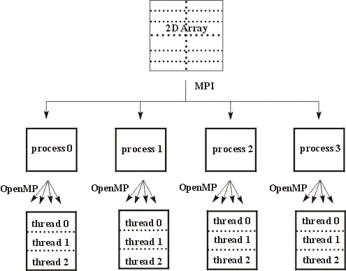
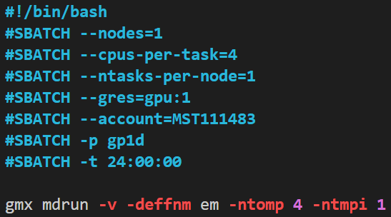
Interactive
sbatch submit.sub
Default name (of the tpr file)
Number of thread mpi (GPU)
Number of openmp (CPUs on the same node)

Slide 14
Interactive
gmx grompp -f nvt.mdp -c em.gro -r em.gro -p topol.top -o nvt.tpr
sbatch nvt.sub
Wait for nvt to finish
gmx grompp -f npt.mdp -c nvt.gro -t nvt.cpt -r nvt.gro -p topol.top -o npt.tpr
sbatch npt.sub
Wait for npt to finish
gmx grompp -f md.mdp -c npt.gro -t npt.cpt -p topol.top -o md_0_10.tpr
sbatch md.sub

Slide 15
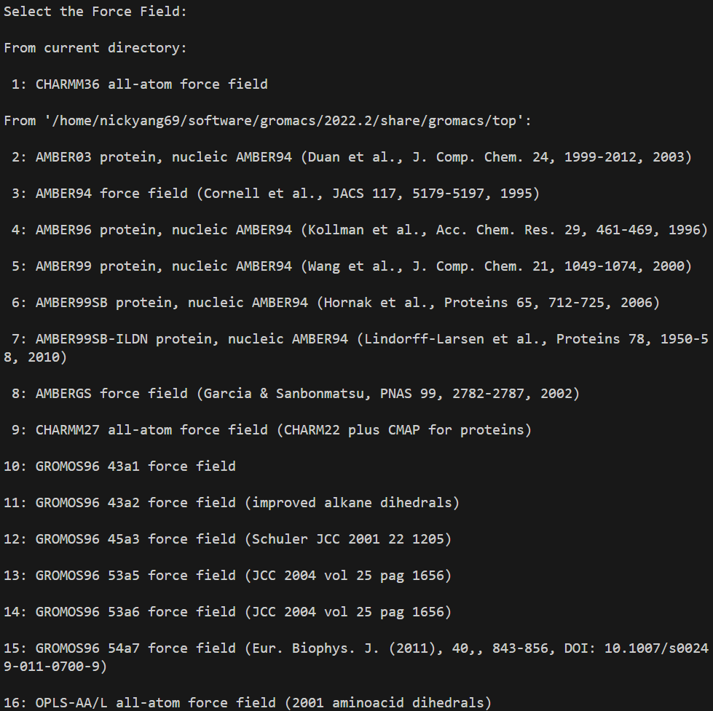
Force field
gmx pdb2gmx -f 1MK5_nowater_nolig.pdb -o 1mk5.gro -water spce -ignh

Slide 16
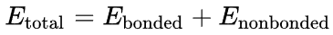
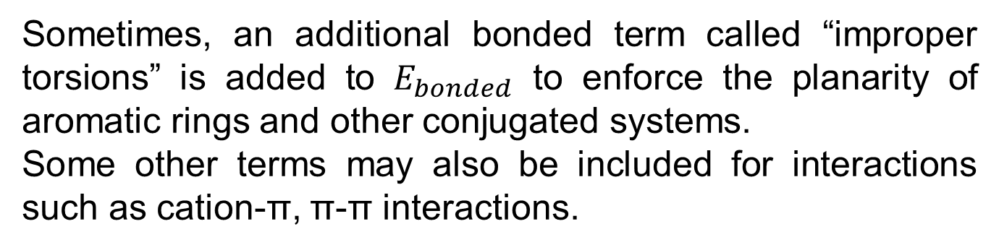
Force field
Force field (FF) is a method to calculate the potential energy of a system by evaluating it using a functional form with given sets of parameters. Usually, the energy of the system is partitioned into:
and each term is further split into:
Sometimes, an additional bonded term called “improper torsions” is added to $E_{bonded}$ to enforce the planarity of aromatic rings and other conjugated systems.
Some other terms may also be included for interactions such as cation-π, π-π interactions.

Slide 17
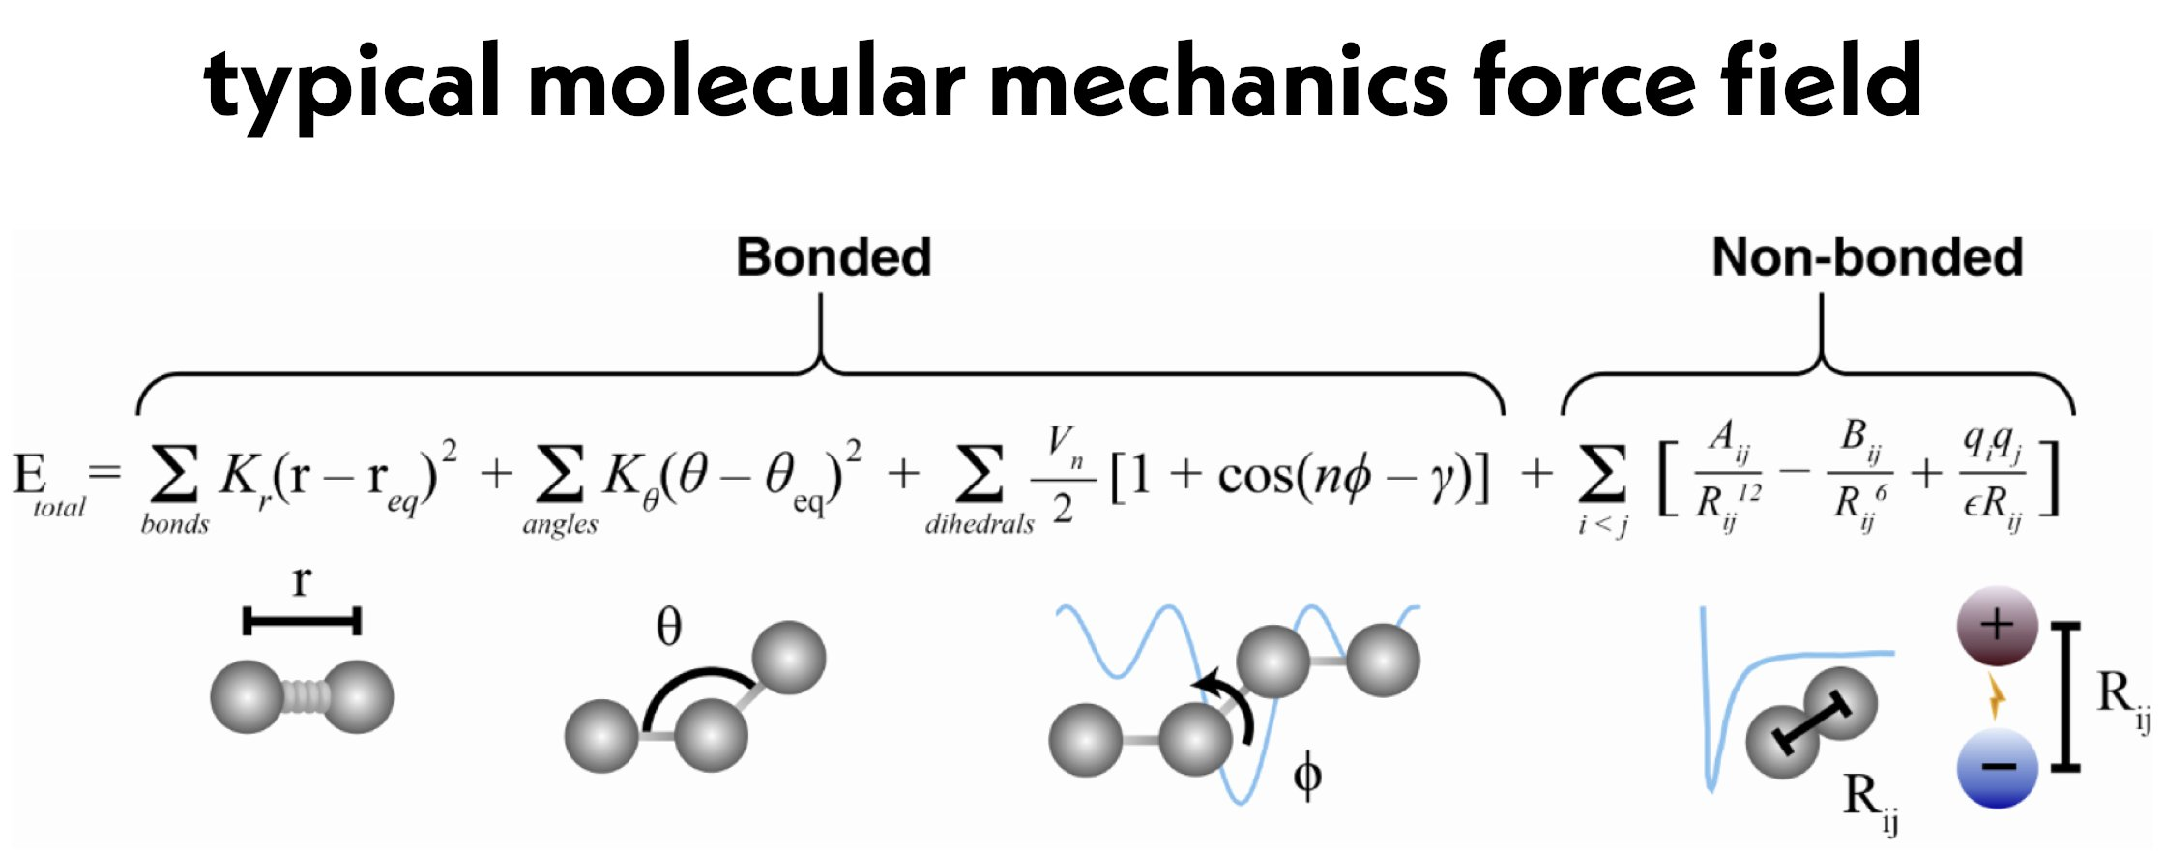
Force field
For the non-bonded term, there are two contributions
The nonbonded term is the most computationally intense term because the number of pairs drastically increases with distance (R³). Hence, cut-off distance is applied to limit the number of interactions.

Slide 18
Force field
Some common force fields are: Optimized Potentials for Liquid Simulations (OPLS), Assisted Model Building with Energy Refinement (AMBER; e.g. ff99), General AMBER force field (GAFF), Chemistry at Harvard Macromolecular Mechanics (CHARMM), Merck molecular force field (MMFF; e.g. MMFF94), Universal force field (UFF)

Slide 19
Force field
gmx pdb2gmx -f 1MK5_nowater_nolig.pdb -o 1mk5.gro -water spce -ignh

Slide 20
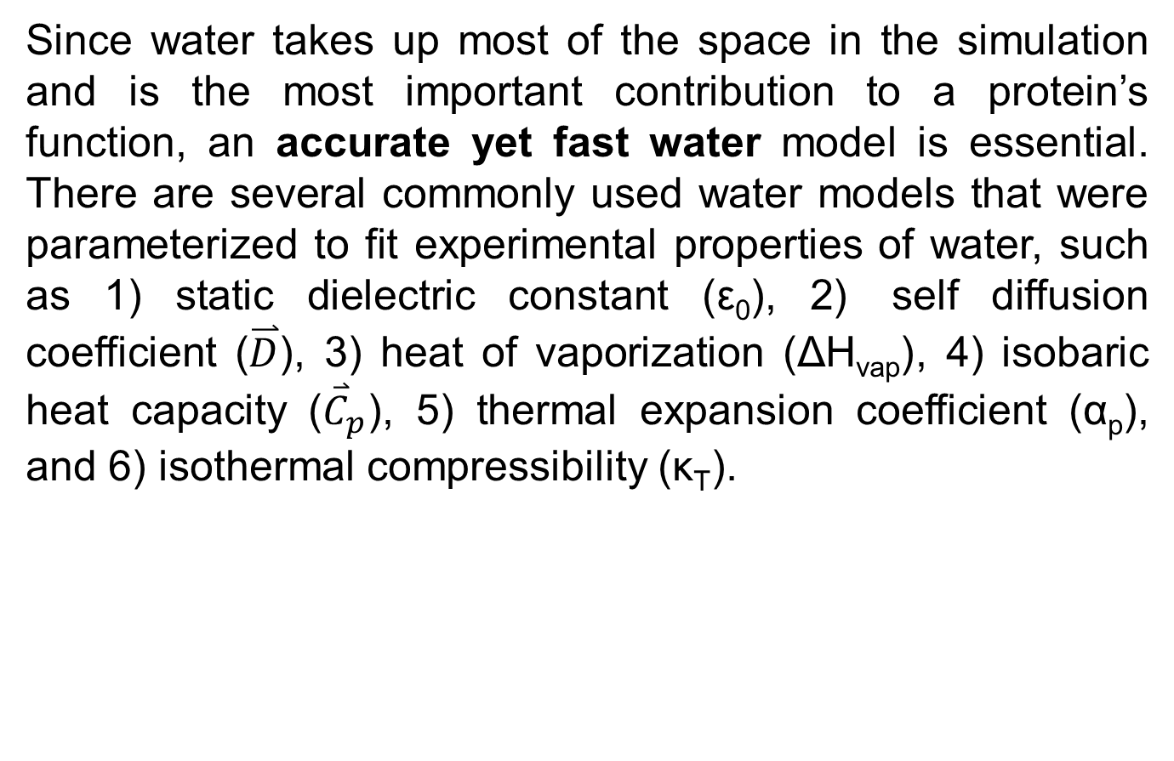
Water model
Since water takes up most of the space in the simulation and is the most important contribution to a protein’s function, an accurate yet fast water model is essential. There are several commonly used water models that were parameterized to fit experimental properties of water, such as 1) static dielectric constant (ε₀), 2) self diffusion coefficient ($\overset{⃑}{D}$), 3) heat of vaporization (ΔH_{vap}), 4) isobaric heat capacity (${\overset{⃑}{C}}_{p}$), 5) thermal expansion coefficient (α_{p}), and 6) isothermal compressibility (κ_{T}).

Slide 21
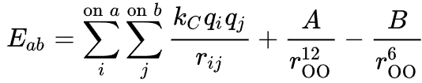
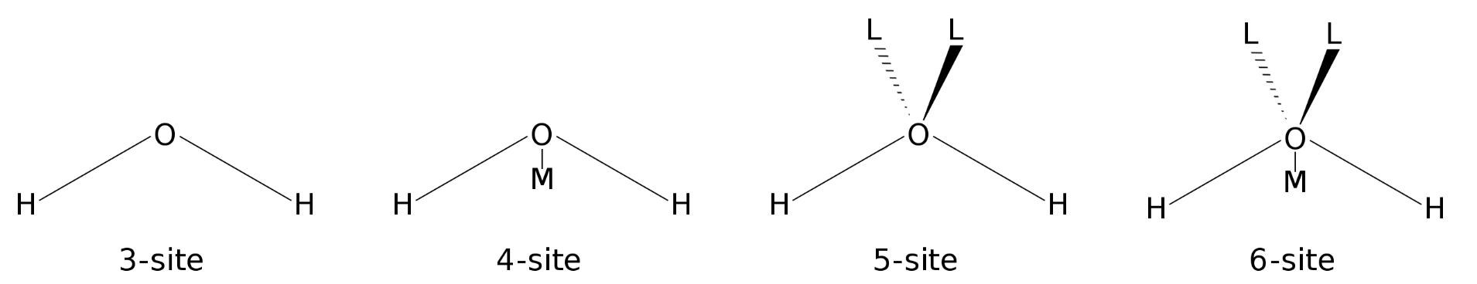
Water model
Water molecules are usually considered rigid.
The interactions between water molecules and water molecules and other molecules are partitioned into electrostatic and dispersive (by Lennard-Jones potential).
Pairwise charge interactions are calculated to different number of sites (points) per water molecule in different models (while LJ terms are usually applied to the oxygen)

Slide 22
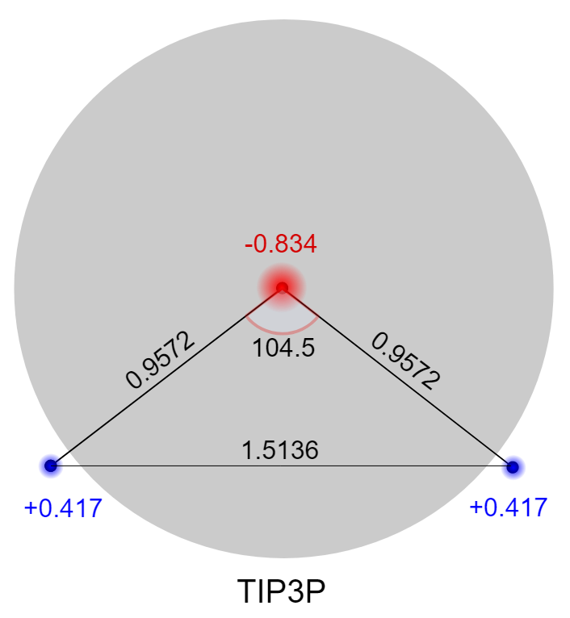
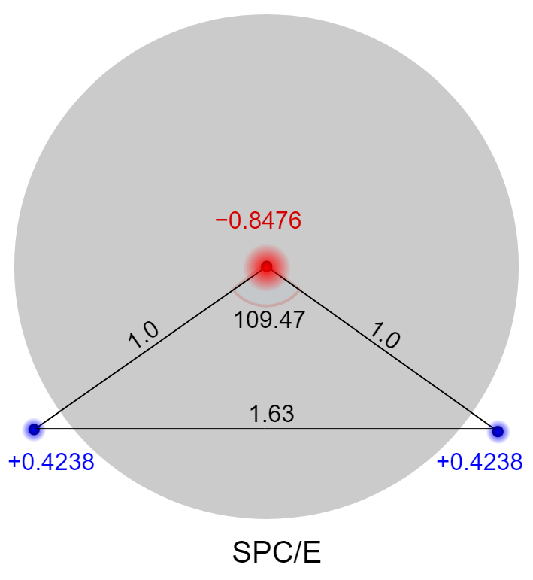
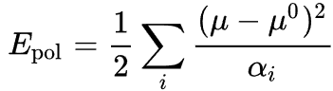
Water model
3 charge 3 point models (efficient):
TIP3P (Transferrable intermolecular potential)
Rigid geometry closely matching actual water molecule.
SPC/E (Simple point charge)
More obtuse tetrahedral angle of 109.47°.
Adds an average polarization correction to the potential energy function.
Reproduces density and diffusion constant better than the original SPC model.

Slide 23
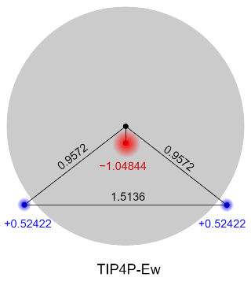
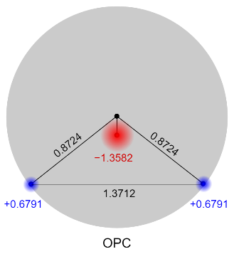
Water model
3 charge 4 point models (more accurate):
TIP4P (Transferrable intermolecular potential)
Improves association/dissociation balance compared to 3-point models.
OPC (Optimal point charges)
No geometrical restraints but a C_{2v} geometry.
Considerably better reproduces the six bulk properties of water.
Removing point charge positioning restrictions allowed for considerably better reproduction of the six bulk properties of water.

Slide 24
Water model
 | TIP3P | SPC/E | TIP4P | OPC
r(OH), Å | 0.9572 | 1.0 | 0.9572 | 0.8724
HOH, deg | 104.52 | 109.47 | 104.52 | 103.6
A, 10³ kcal Å¹²/mol | 582.0 | 629.4 | 600.0 | 865.1
B, kcal Å⁶/mol | 595.0 | 625.5 | 610.0 | 858.1
q(O)/q(M) | −0.834 | −0.8476 | −1.04 | −1.3582
q(H) | +0.417 | +0.4238 | +0.52 | +0.6791
r(OM), Å |  |  | 0.15 | 0.1594

Slide 25
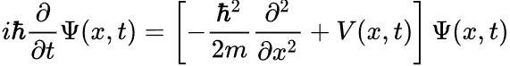
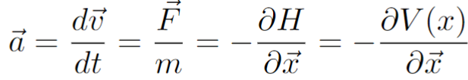
Classical molecular dynamics
The time evolution of a system governs the majority of its properties. Hence, the study of the time-dependent phenomena is a crucial part of molecular modeling. Quantum mechanically, it is possible to study a time evolution process by time-dependent Schrödinger equation.
However, this is very expensive to solve, and sometimes the time evolution of the electronic state is not the focus of the study. Therefore, it is convenient to result to classical Newtonian dynamics by solving the equation of motion.

Slide 26
Interactive
Go to Exercise2
Copy over 1MK5_nowater_nolig.pdb, charmm36-jul2021.ff
gmx editconf -f lig.pdb -o lig.gro
gmx pdb2gmx -f 1MK5_nowater_nolig.pdb -water spce -ignh -o 1mk5-lig.gro
1
Save the last line of 1mk5.gro somewhere (write down, a file, or however you like)
Remove the last line of 1mk5-lig.gro
Add lig coordinates to 1mk5-lig.gro by:
grep ‘lig’ lig.gro >> 1mk5-lig.gro
Add the removed last line back to 1mk5-lig.gro
Update the number of atoms in 1mk5-lig.gro to reflect the new number of atoms after those added from lig (3565)

Slide 27
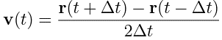
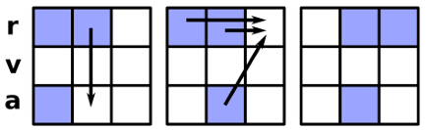
Classical molecular dynamics
Positions are then updated using Taylor expansions:
Add these two equations together:
Velocity is then calculated by central difference
This is called Verlet integrator

Slide 28
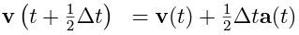
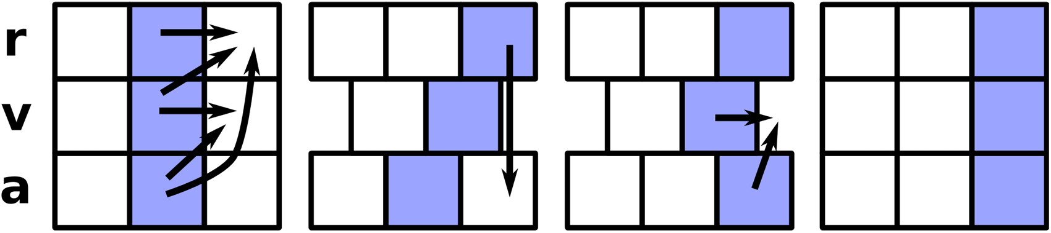
Classical molecular dynamics
Since velocity is not treated explicitly in Verlet integrator, it is naturally to improve it by expanding both r(t) and v(t):
Velocity is first updated at “mid-step”, $t=t+\frac{δt}{2}$
Then positions are updated using the calculated velocity

Slide 29
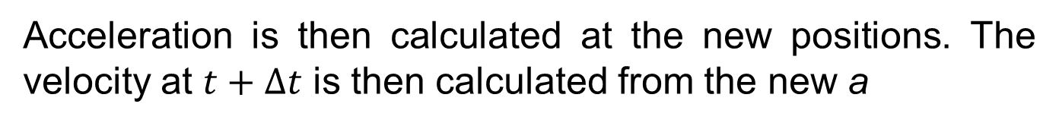
Classical molecular dynamics
Acceleration is then calculated at the new positions. The velocity at $t+Δt$ is then calculated from the new a
This is called Velocity Verlet (VV) integrator

Slide 30
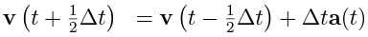
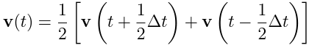
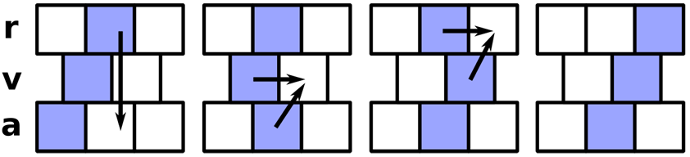
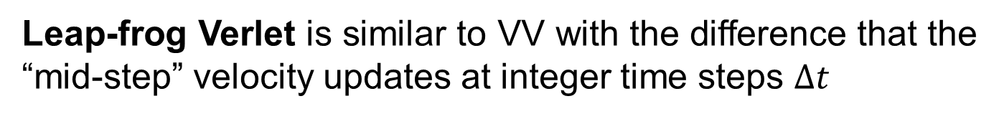
Classical molecular dynamics
Leap-frog Verlet is similar to VV with the difference that the “mid-step” velocity updates at integer time steps $Δt$
Positions are similarly updated from the calculated velocity
Current velocity is only calculated on demand using central difference.

Slide 31
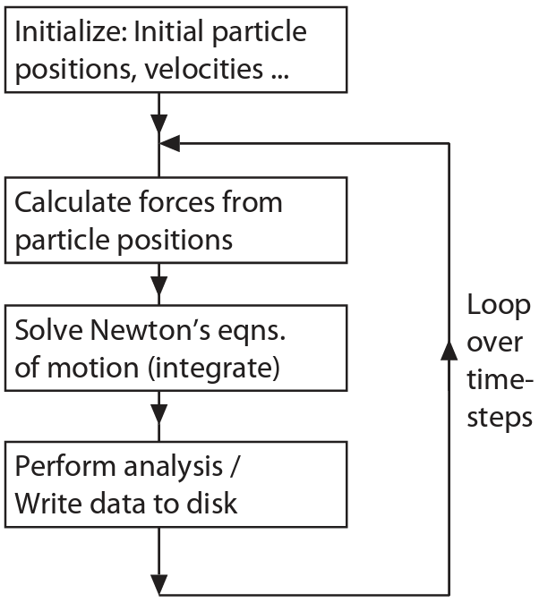
Classical molecular dynamics
The whole classical MD workflow is then:

Slide 32
Interactive
Go to Exercise2
Copy over 1MK5_nowater_nolig.pdb, charmm36-jul2021.ff
gmx editconf -f lig.pdb -o lig.gro
gmx pdb2gmx -f 1MK5_nowater_nolig.pdb -water spce -ignh -o 1mk5-lig.gro
1
Save the last line of 1mk5.gro somewhere (write down, a file, or however you like)
Remove the last line of 1mk5-lig.gro
Add lig coordinates to 1mk5-lig.gro by:
grep ‘lig’ lig.gro >> 1mk5-lig.gro
Add the removed last line back to 1mk5-lig.gro
Update the number of atoms in 1mk5-lig.gro to reflect the new number of atoms after those added from lig (3565)

Slide 33
Interactive
Now we need to generate the topol.top file from 1mk5-lig.gro and update it to include the information about lig.
In the topol.top file:
Before Include water topology, add
; Include ligand topology
#include "lig.itp"
Before Include chain topologies, add
; Include ligand parameters
#include "lig.prm"
At the end of the file, add
lig 1

Slide 34
Interactive
Let’s box, solvate, and neutralize the system, then remove clash interactions
gmx editconf -f 1mk5-lig.gro -c -d 1.0 -bt dodecahedron -o 1mk5-lig_box.gro
gmx solvate -cp 1mk5-lig_box.gro -cs spc216.gro -o 1mk5-lig_box_solvate.gro -p topol.top
gmx grompp -f ions.mdp -c 1mk5-lig_box_solvate.gro -p topol.top -o ions.tpr
gmx genion -s ions.tpr -o 1mk5-lig_box_solvate_ion.gro -p topol.top -pname NA -nname CL -neutral
15
gmx grompp -f minim-protein-ligand.mdp -c 1mk5-lig_box_solvate_ion.gro -p topol.top -o em.tpr
sbatch em.sub

Slide 35
Interactive
Before we can run NVT, we need to restrain the ligand
gmx make_ndx -f lig.gro -o index_lig.ndx
0 & ! a H*
q
gmx genrestr -f lig.gro -n index_lig.ndx -fc 1000 1000 1000 -o posre_lig.itp
3
In the topol.top file:
Before Include water topology, add
; Ligand position restraints
#ifdef POSRES_LIG
#include "posre_lig.itp"
#endif

Slide 36
Interactive
We can run NVT, NPT, MD after we write the index of protein and ligand
gmx make_ndx -f em.gro -o index.ndx
1 | 13
q
gmx grompp -f nvt-protein-ligand.mdp -c em.gro -r em.gro -p topol.top -n index.ndx -o nvt.tpr
sbatch nvt.sub
Wait for nvt to finish
gmx grompp -f npt-protein-ligand.mdp -c nvt.gro -t nvt.cpt -r nvt.gro -p topol.top -n index.ndx -o npt.tpr
sbatch npt.sub
Wait for npt to finish
gmx grompp -f md-protein-ligand.mdp -c npt.gro -t npt.cpt -p topol.top -n index.ndx -o md_0_10.tpr
sbatch md.sub

Slide 37
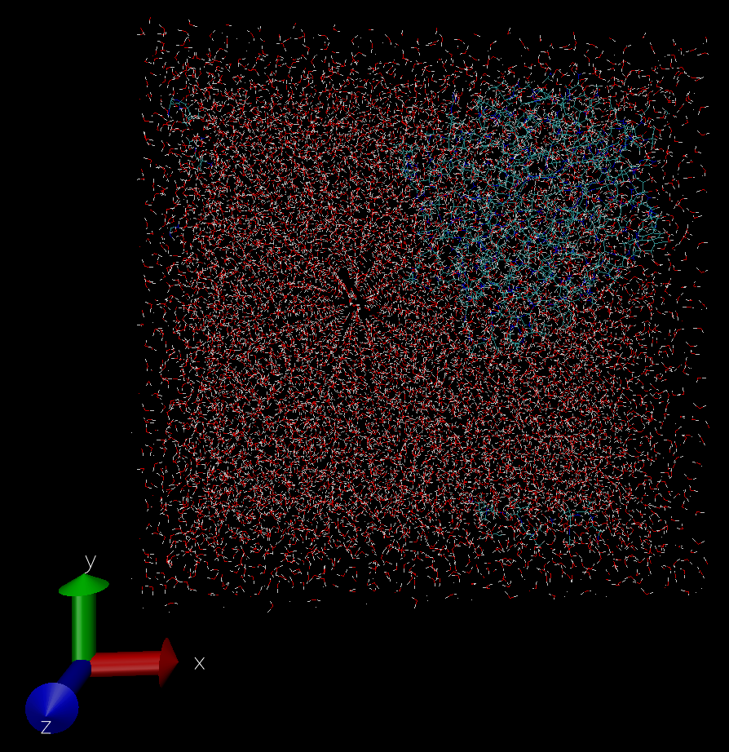
Interactive
Now, let’s visualize the files from Exercise 1 and learn about them
Download md_0_10.gro from the server
Open VMD
Under VMD Main, File > New Molecule…
Under Molecule File Browser, Browse…, choose 1mk5_box_solvate_ion.gro, Load

Slide 38
Interactive
It is hard to see the tertiary structure of the protein in this representation.
Under VMD Main, Graphics > Representations…
(Make sure that the selected molecule is correct) Click Create Rep, Click Create Rep AGAIN.
While the first Rep is highlighted, type under “Selected Atoms” all protein then hit enter
Change “Coloring Method” from Name to Secondary Structure.
Change “Drawing Method” from Lines to NewCartoon.

Slide 39
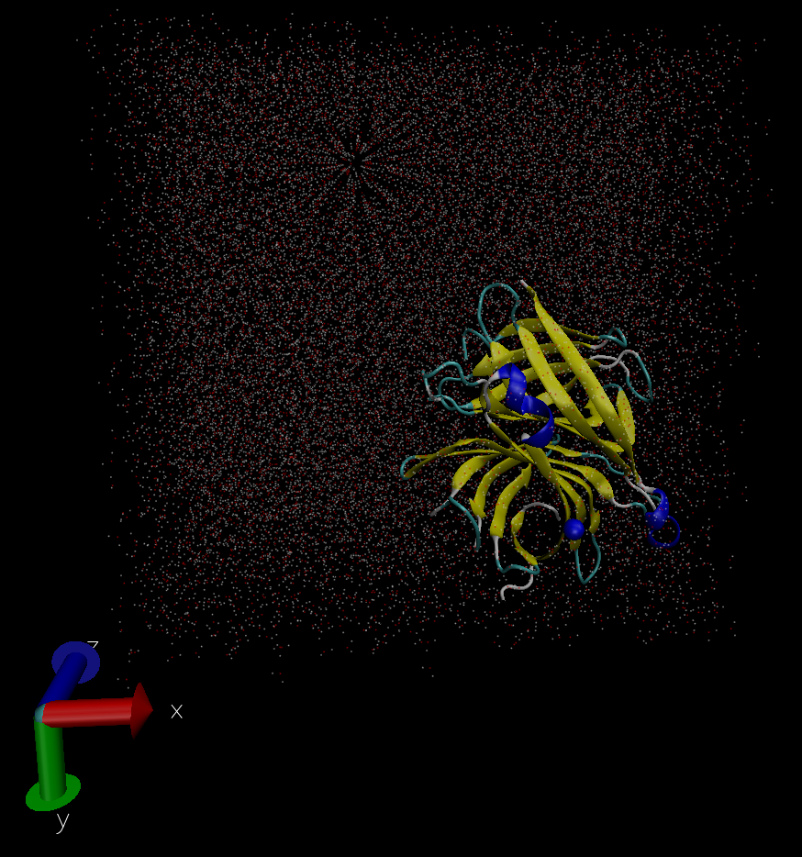
Interactive
While the second Rep is highlighted, type under “Selected Atoms” all water then hit enter
Change “Drawing Method” from Lines to Points.
While the third Rep is highlighted, type under “Selected Atoms” all ions then hit enter
Change “Drawing Method” from Lines to VDW.

Slide 40
Interactive
Let’s import the trajectory into the structure
Download md_0_10.xtc from the server
Under Molecule File Browser, make sure it shows Load files for: 0: md_0_10.gro
Clock Browse…, choose md_0_10.xtc, Load
Wait for the loading to finish
Now you can play around with the frames under VMD Main using the buttons and progress bar.
The screen is flooded with molecules. You can double click on the second Rep under Graphic Representation to hide the water molecules.
In the display window, click T to translate, R to rotate, S to scale.

Slide 42
Interactive
Now, let’s visualize the files from Exercise 2
Repeat what you have done for Exercise 1
Add in Graphic Representation an extra Rep:
resname lig and change the Drawing Method to Licorie.

Slide 43
Interactive
You may immediate notice a few differences:
For the first snapshot, the proteins are bound to each other and the ligands seem outside the protein
It is very hard to follow the protein-ligand motions when the whole complex is drifting across the periodic boundary.

Slide 44
Interactive
It is often a good idea to center the protein to the simulation box and superimpose the backbone of the protein so we can focus on the motion of the ligands inside the protein.
gmx trjconv -s md_0_10.tpr -f md_0_10.xtc -center -pbc mol -ur compact -o md_0_10_center.xtc
1
0
gmx trjconv -s md_0_10.tpr -f md_0_10_center.xtc -fit rot+trans -o md_0_10_center_fit.xtc
4
0
gmx trjconv -s md_0_10.tpr -f md_0_10_center.xtc -dump 0 -o md_0_10_center_start.pdb
0

Slide 45
Interactive
Now load the movie using md_0_10_center_start.pdb as your first frame and md_0_10_center_fit as the trajectory.

